Slide 1

React JS
Ahmed Elashry
aelashry@outlook.com

Slide 2
React
React is a JavaScript library for building user interfaces ,
developed at Facebook and released to the world in 2013.
Current stable version : 18.x.x

Slide 3
Why React ?
Easy creation of
dynamic applications.
Improved performance
using Virtual DOM.
Reusable components
Easy to learn.
Dedicated tools for easy debugging.

Slide 4
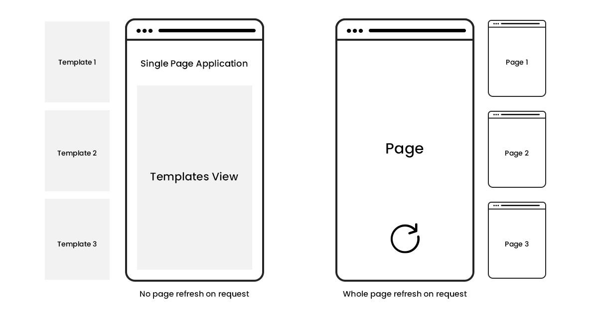
Single page application

Slide 5
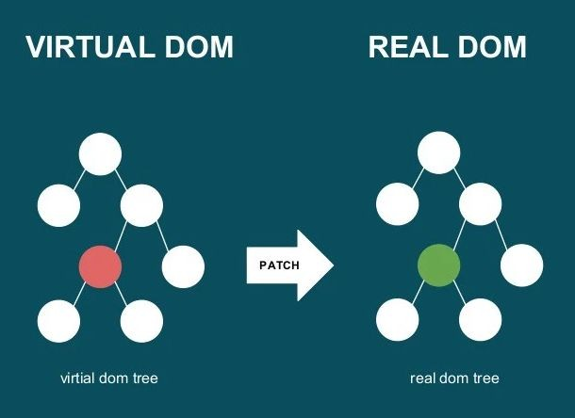
Virtual DOM
The virtual DOM is only a virtual representation of the DOM

Slide 6
Virtual DOM
When new elements are added to the UI, a virtual DOM, which is represented as a tree is created.
Each element is a node on this tree. If the state of any of these elements changes, a new virtual DOM tree is created.
This tree is then compared with the previous virtual DOM tree, the virtual DOM calculates the best possible method to make these changes to the real DOM. This ensures that there are minimal operations on the real DOM.

Slide 7
Getting started
Add React to an Existing Project
If you want to add some interactivity to your existing project, you don’t have to rewrite it in React. Add React to your existing stack, and render interactive React components anywhere.
npm install react react-dom react-scripts
Notes:
npm install react react-dom react-scripts
"scripts": {
"start": "react-scripts start"
},

Slide 8
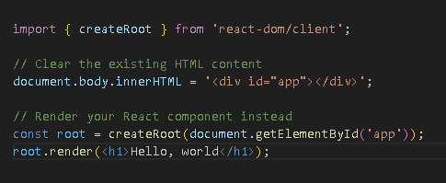
Getting started
Notes:
import { createRoot } from 'react-dom/client';
// Clear the existing HTML content
document.body.innerHTML = '<div id="app"></div>';
// Render your React component instead
const root = createRoot(document.getElementById('app'));
root.render(<h1>Hello, world</h1>);

Slide 9
Getting started
Install node : https://nodejs.org/en/
Open new terminal in your directory.
Create new react app : npx create-react-app app-name
Enter your app folder.
Run your react app : npm start

Slide 10
React app structure
JSX stands for JavaScript XML and allows us to write HTML in React.
With JSX :
const root=createRoot(document.getElementById('app'))
const myelement = <h1>I Love JSX!</h1>;
root.render(myelement)
Without JSX :
const root=createRoot(document.getElementById('app'))
const myelement = React.createElement('h1', {}, 'I do not use JSX!');
root.render(myelement)
Try : https://babeljs.io/
Notes:
const root=createRoot(document.getElementById('app'))
//const myelement = <h1>I Love JSX!</h1>;
const myelement = React.createElement('h1', {}, 'I do not use JSX!');
root.render(myelement)

Slide 11
Class vs Functional component
Component represent the part of user interface , before React Hooks (will be discussed later ) when we want to create a dynamic component, we have to create a class component and use lifecycle methods to change states to make it reusable and encapsulate.
It is regular ES6 classes that extends component class form react library, also known as “stateful” components because they implement logic and state.It must have render() method returning html.

Slide 12
Class vs Functional component
Functional component :
const App = ( ) => {return (<h1> Hello </h1>)};
Class component :
class App extends Component{
render( ){
return (<h1> Hello </h1>)}
};
Notes:
//Functional component :
const App = ( ) => {return (<h1> Hello </h1>)};
//Class component :
class App extends Component{
render( ){
return (<h1> Hello </h1>)}
};

Slide 13
Component lifecycle
There are 3 phases in a React component lifecycle:
Mounting
the JSX that builds the component interface.
Updating
when the component has been updated in the DOM. Use this to call APIs that must be updated when the DOM changes
Unmounting
component is removed from the DOM. Use this to do any sort of cleanup you need to perform.

Slide 14
props
Props is short for properties and they are used to pass data between React components. React’s data flow between components is uni-directional (from parent to child only).
In a class component, props are passed by default. There is no need to add anything special, and they are accessible as this.props in a Component instance.

